Slide 1

Parking Lot Monitoring System – Ground Based Approach
By: Abdulrahman Alrudayan, Khalifah Altamimi, Brady Beecham, Kyle Plant, Michael Sisk
Supervisor: Jesse Roberts
NAVSEA Representatives: Kristen Voyles, Rob Sexton
Notes:
Hello, I’m a part of capstone team 6, we are working on the parking lot monitoring system, and I’m going to give a brief introduction to our project.

Slide 2
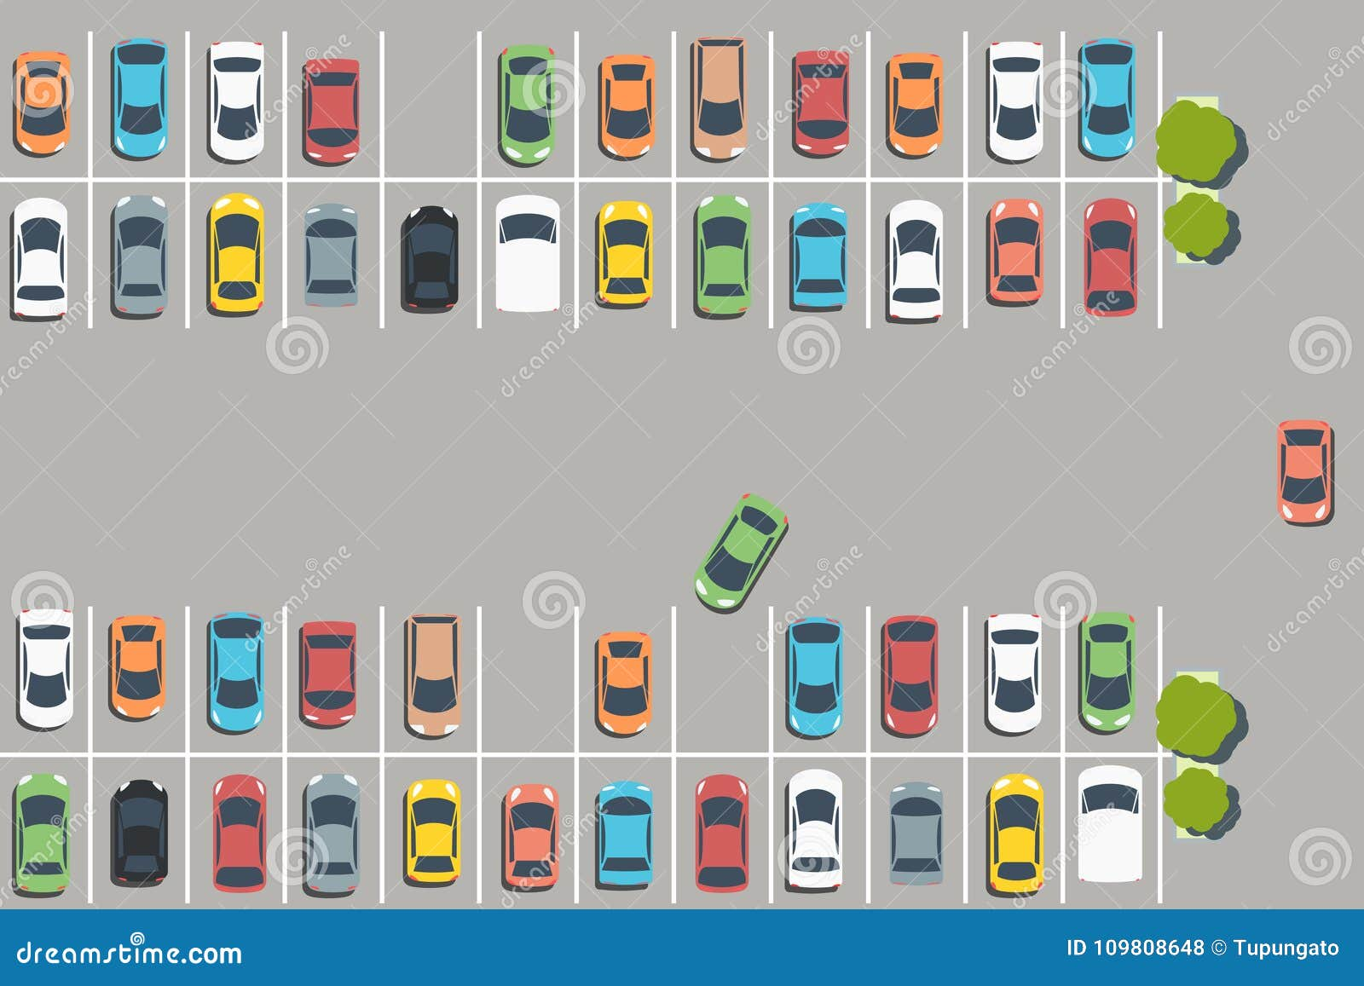
The Problem
Parking spots near the center of Tech’s campus are at a premium.
Cameras and AI were previously used to track vehicle count.
Tupungato. “Full Parking Lot Stock Vector. Illustration of Entertainment - 109808648.” Dreamstime, 18 Feb. 2018, www.dreamstime.com/parking-lot-illustration-vector-car-park-infrastructure-graphics-full-parkinglot-image109808648.
Notes:
Stakeholders:
Students and Faculty
Literally anybody on campus that wants to park

Slide 3
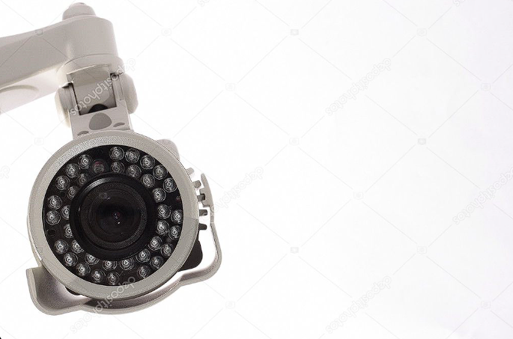
Camera Problems
Cameras | Condition
No | Reliability under different weather conditions
Some | Parking Lot Applicability
Yes | Potential Privacy Concerns
“Security Camera Stock Photos.” Depositphotos, depositphotos.com/photos/security-camera.html?offset=480&filter=all&qview=2369650. Accessed 24 Apr. 2024.
Notes:
We discovered camera problems:
No vision during the night or many weather conditions
Can’t cover all parking lots (like gravel lot)

Slide 4
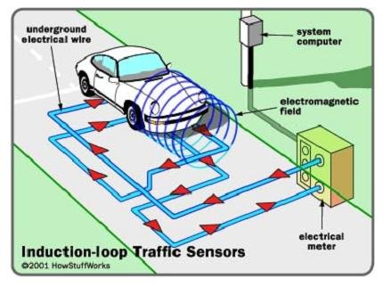
Cameras vs Inductive Loops
Cameras | Condition | Inductive Loops
No | Reliability under different weather conditions | Yes
Some | Parking Lot Applicability | Most
Yes | Potential Privacy Concerns | No
“Security Camera Stock Photos.” Depositphotos, depositphotos.com/photos/security-camera.html?offset=480&filter=all&qview=2369650. Accessed 24 Apr. 2024.
An Inductive-Loop Detection System [49]. | Download Scientific Diagram, www.researchgate.net/figure/An-inductive-loop-detection-system-49_fig4_299471883. Accessed 24 Apr. 2024.
Notes:
We discovered camera problems:
No vision during the night or many weather conditions
Can’t cover all parking lots (like gravel lot)

Slide 5
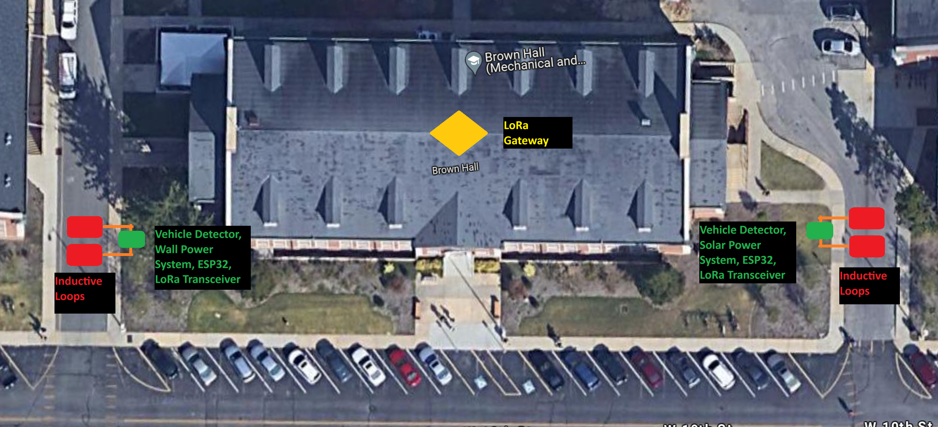
Proposed Solution
Notes:
Inductive Loops provide more reliable vehicle detection
One sensor and two inductive loops for each entrance and exit

Slide 6
Measures of Success
Measure of Success | Details
Full Time Operation | All parts of the system shall be constantly functioning. This includes having a backup power supply.
Wireless Communication | The sensor shall communicate with the server wirelessly.
Space Availability Retention | The system shall keep a count of vehicles that enter or exit a parking lot.
Local Space Availability Retention | The sensor shall keep track of the number of vehicles in a parking lot locally.

Slide 7
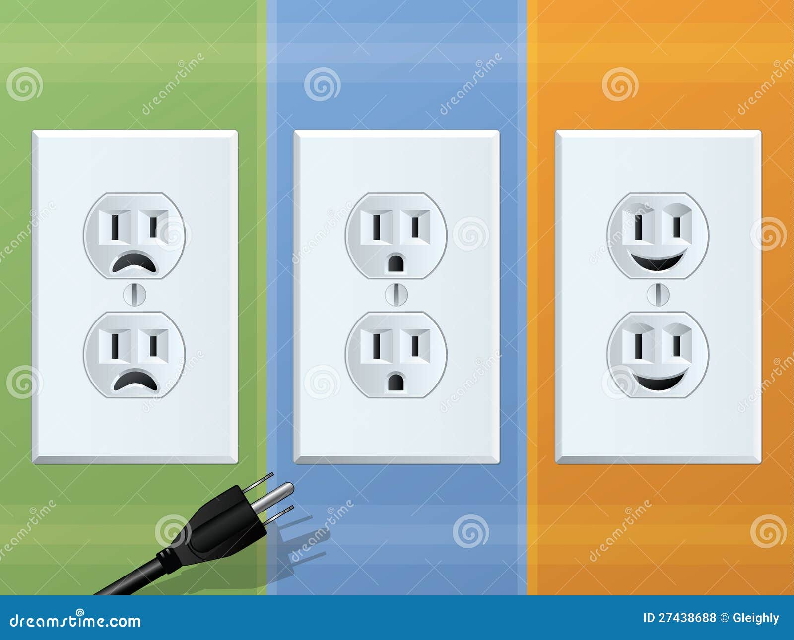
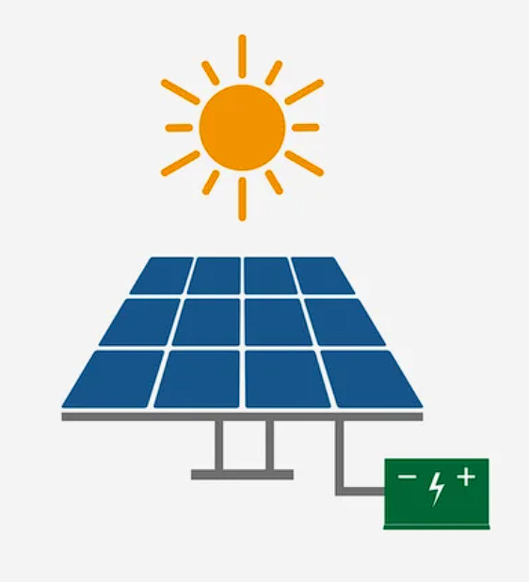
Power Systems
Wall Power
Solar Power
Gleighly. “Power Outlet Cartoon Stock Vector. Illustration of Environmental - 27438688.” Dreamstime, 9 Nov. 2012, www.dreamstime.com/royalty-free-stock-photos-power-outlet-cartoon-image27438688.
“4,569 Solar Panel and Battery Flat Vector Images - Page 10 | Depositphotos.” Depositphotos, depositphotos.com/vectors/solar-panel-and-battery-flat.html?offset=900&sorting=best_sales&qview=215518638.
Notes:
Two Power Systems:
Wall Power for lots near big buildings (less sunlight).
Solar Power for lots further away from buildings (no outlets)

Slide 8
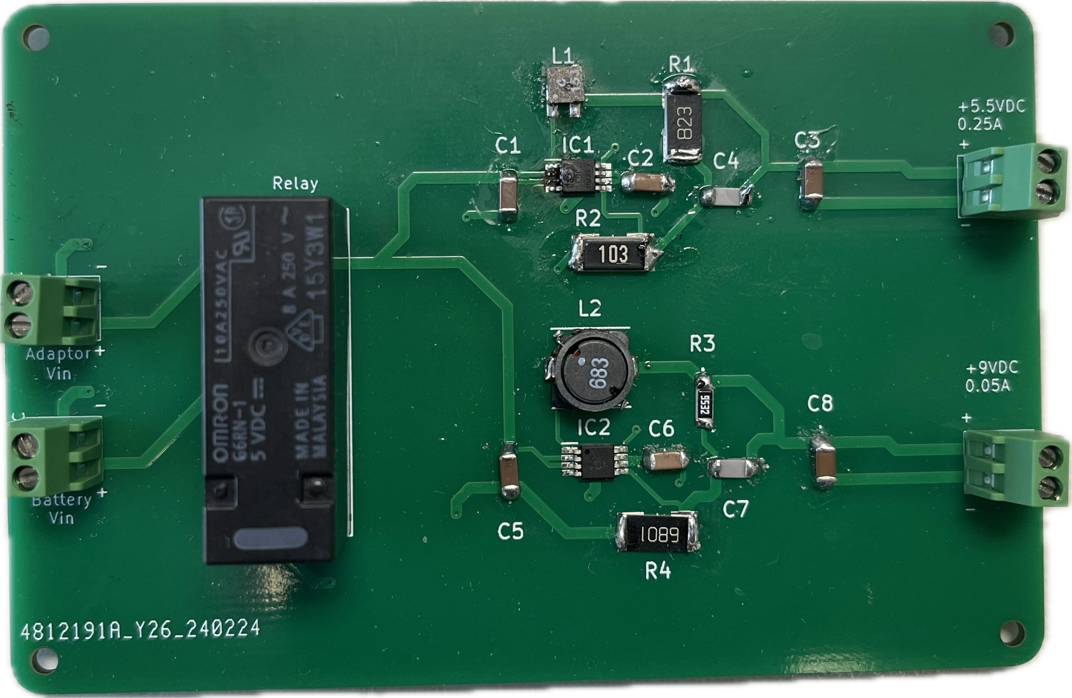
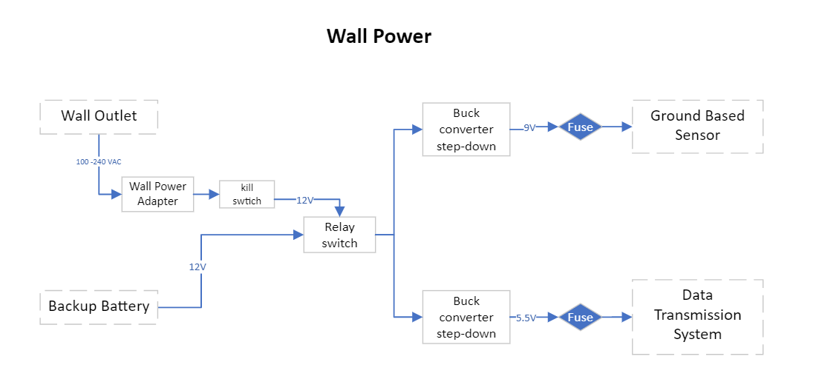
Power Systems cont. Wall Power
Notes:
Goal: Take wall power or battery power and buck it down before sending it out to the other subsystems

Slide 9
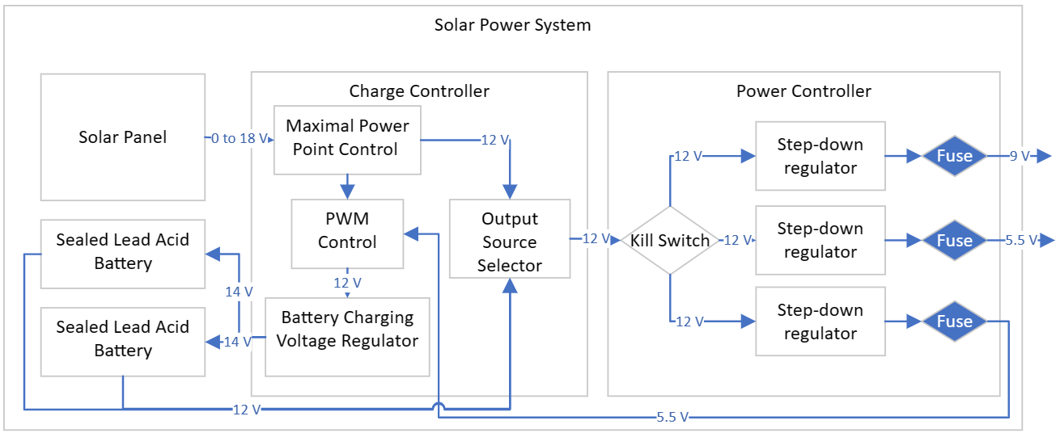
Power Systems cont. Solar Power

Slide 10
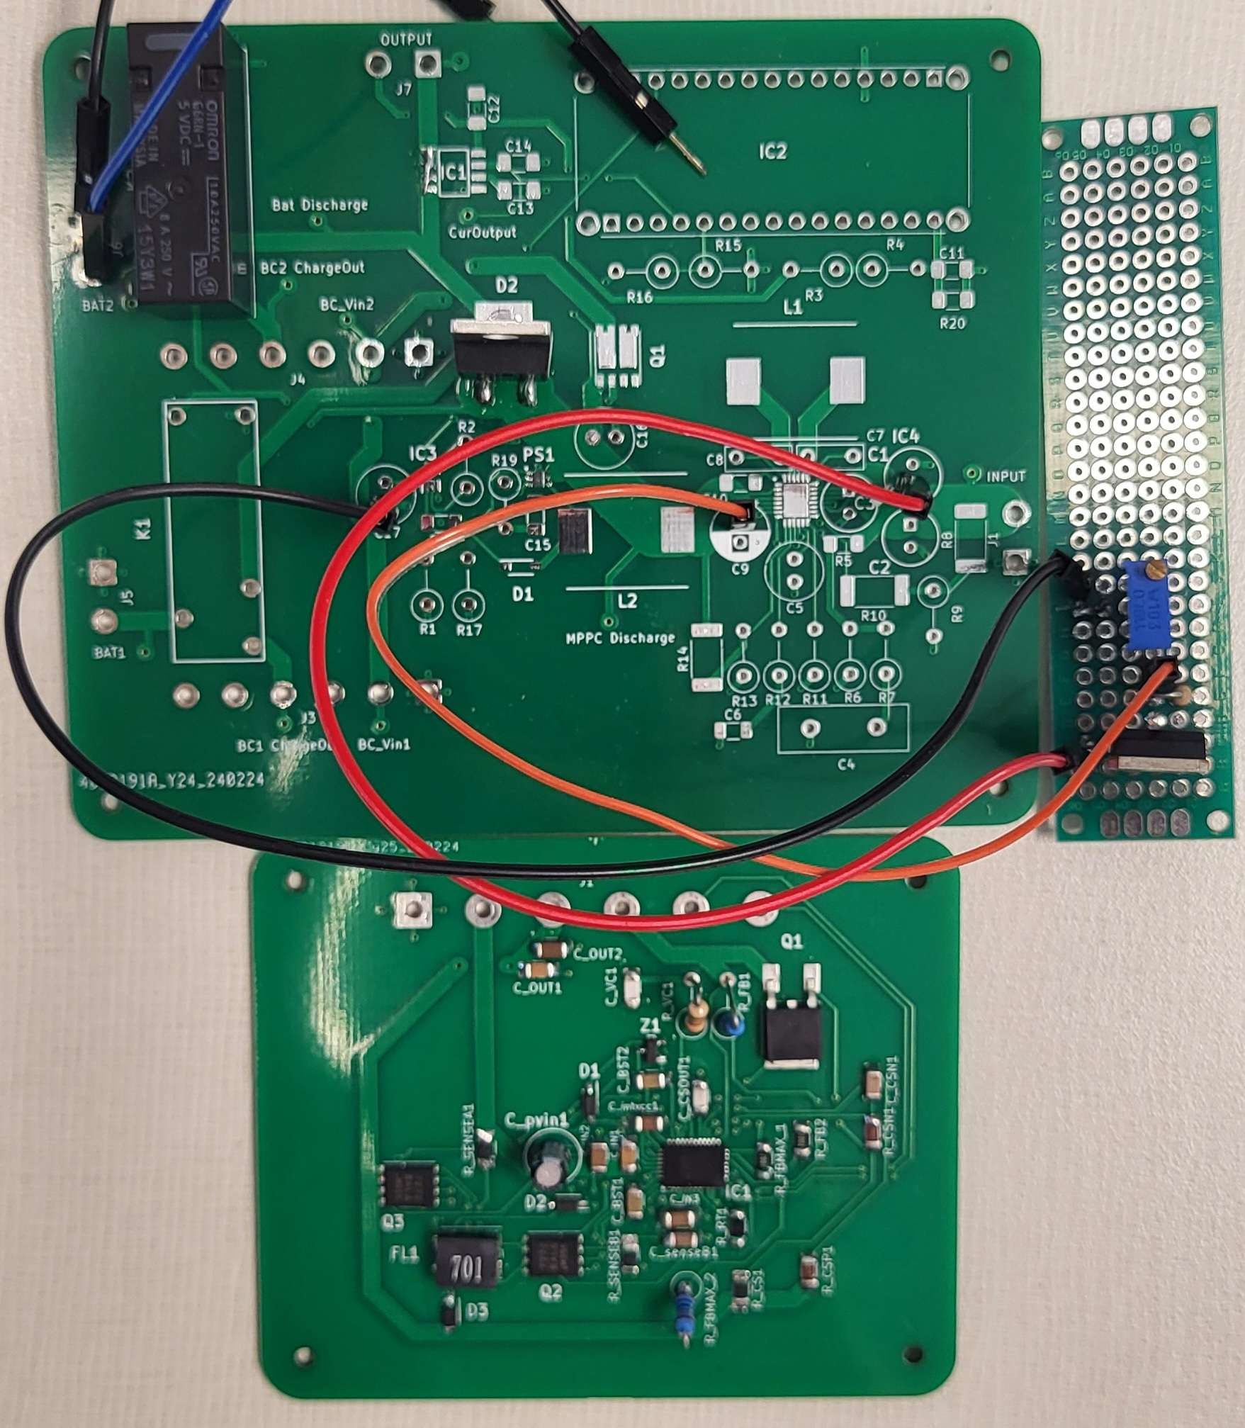
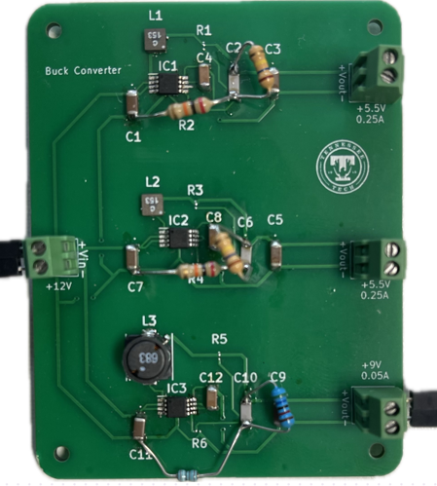
Power Systems Cont. Solar Power
Charge Controller PCBs
Power Controller PCB
Notes:
Charge Controller was an ambition subsystem
Similar to a high-end power controller

Slide 11
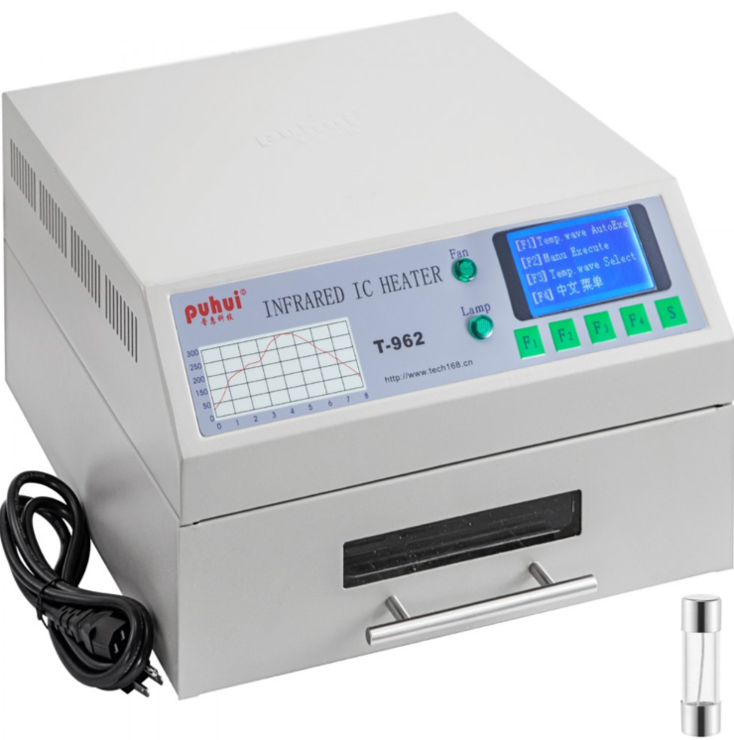
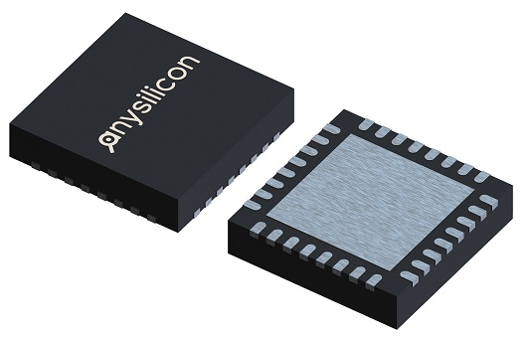
Charge Controller Problems
Anysilicon. “The Ultimate Guide to QFN Package.” AnySilicon, 12 June 2022, anysilicon.com/ultimate-guide-qfn-package/.
QFN = quad-flat no-leads
“VEVOR Reflow Oven T962 110V Reflow Soldering Machine 800W 180 X 235 Mm Professional Infrared Heater Soldering Machine Automatic Reflow Machine (T962 110V) | VEVOR US.” Vevor, www.vevor.com/reflow-oven-c_10068/reflow-oven-reflow-soldering-machine-t962-smd-bga-infrared-ic-heater-180x235-mm-p_010849561276. Accessed 24 Apr. 2024.
‌

Slide 12
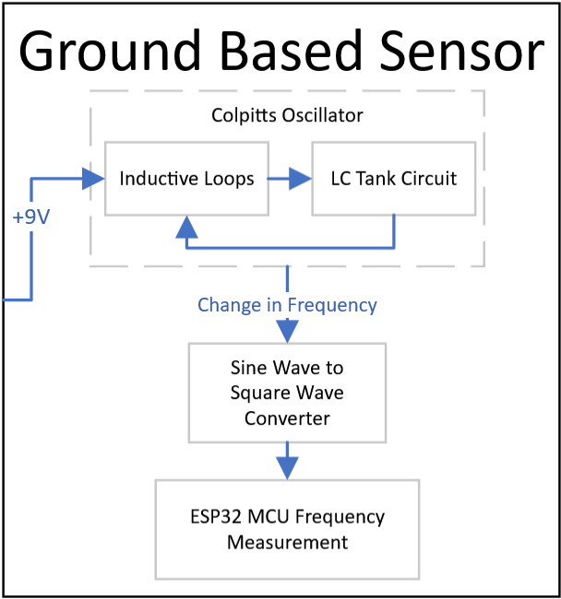
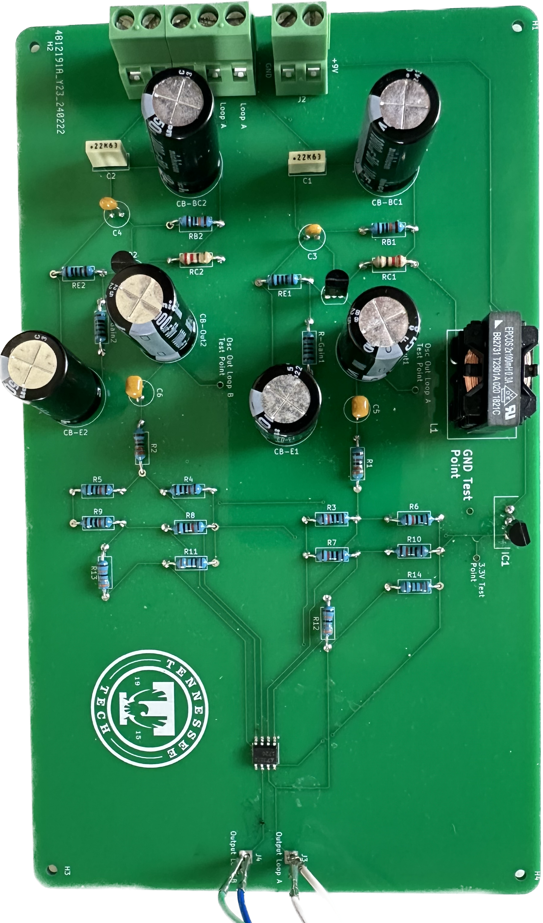
Loop Controller
Notes:
Block Diagram of the Loop Controller and how it functions (left) and PCB of Loop Controller (right).
Explain what Loop Controller is to IAB so basic knowledge is given. What does it do?
Basic working of the Loop Controller
Eddy currents change when a vehicle passes over the loops, causing a reduced inductance and increase in frequency.
When frequency is increased, change is detected in ESP32.
Theory Behind Loop Controller
LC Tank Circuit and Inductive Loops rely on each other to set the oscillation frequency.
Inductive Loops and Capacitors are in parallel with each other. Start with capacitors charging and discharging, thus charging inductive loops and then discharge then repeat.
Process repeated thus causing the oscillations and result is stable frequency.
Due to the tapped capacitance (electric field of two capacitors is the same) of the circuit, the change in inductance from the loops is more stable in frequency.

Slide 13
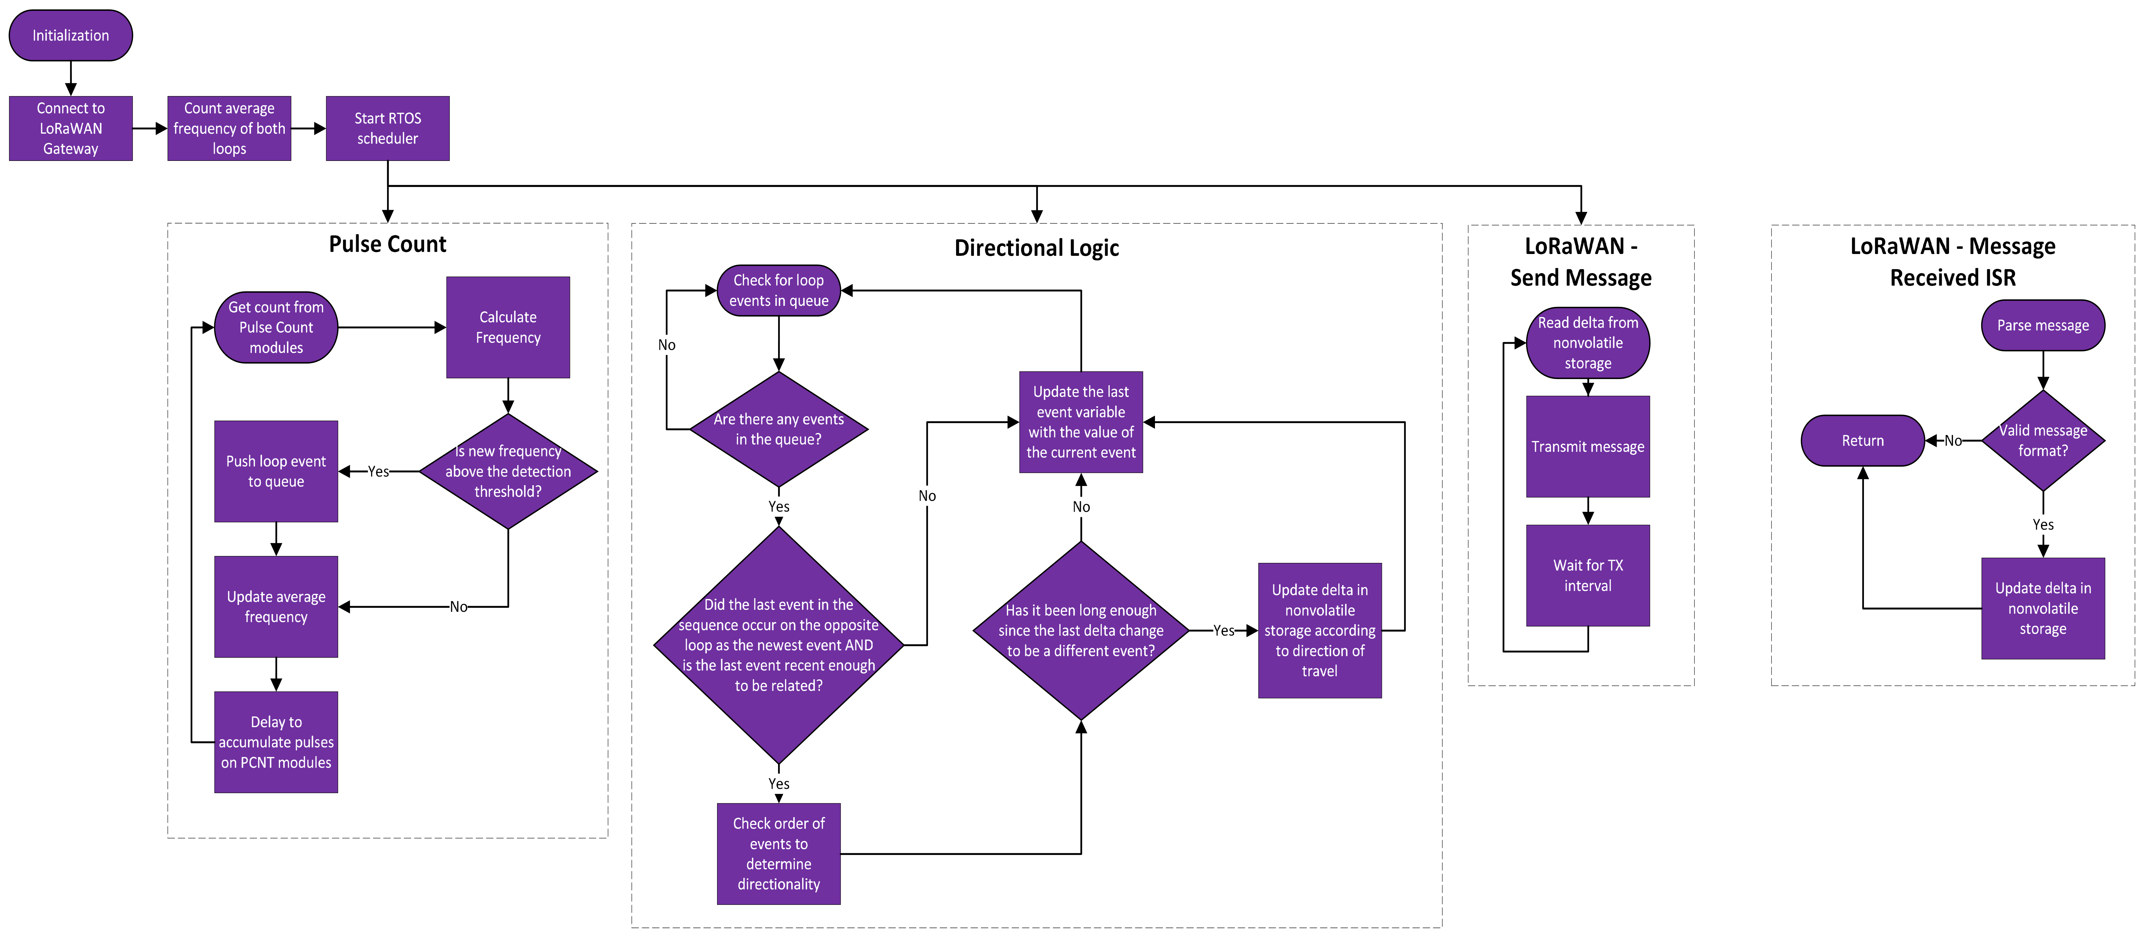
Data Processing – ESP32 Vehicle Detection
Notes:
The ESP32 is running a real time operating system with 3 tasks that run concurrently and one ISR.
The Pulse count, directional logic, and Send Message tasks, and the Message Received ISR.
The pulse count passively accumulates square wave pulses from the loop controller using the ESP’s Pulse Count hardware modules and gets the time elapsed since the last sample was taken to determine the frequency for a sample.
Directional logic makes decisions based on those frequency measurements and their timestamps.
Directional logic’s purpose is to update a value we call the delta.
The delta is a variable that keeps track of the number of vehicles past the loops and their direction based on the sign of the number.
For example a positive delta means more cars have entered the lot at this point then exited and vice versa.
So, directional logic decides the direction the vehicle is traveling and updates the delta accordingly.
The delta is stored in nonvolatile storage so it keeps its value when power is lost.
And the Send Message task reads the delta from NVS and sends the delta to the LoRaWAN gateway at a set interval.
The LoRaWAN Message Received ISR is triggered when a downlink is received from the gateway.
The contents of the message are used to remotely set the delta.

Slide 14
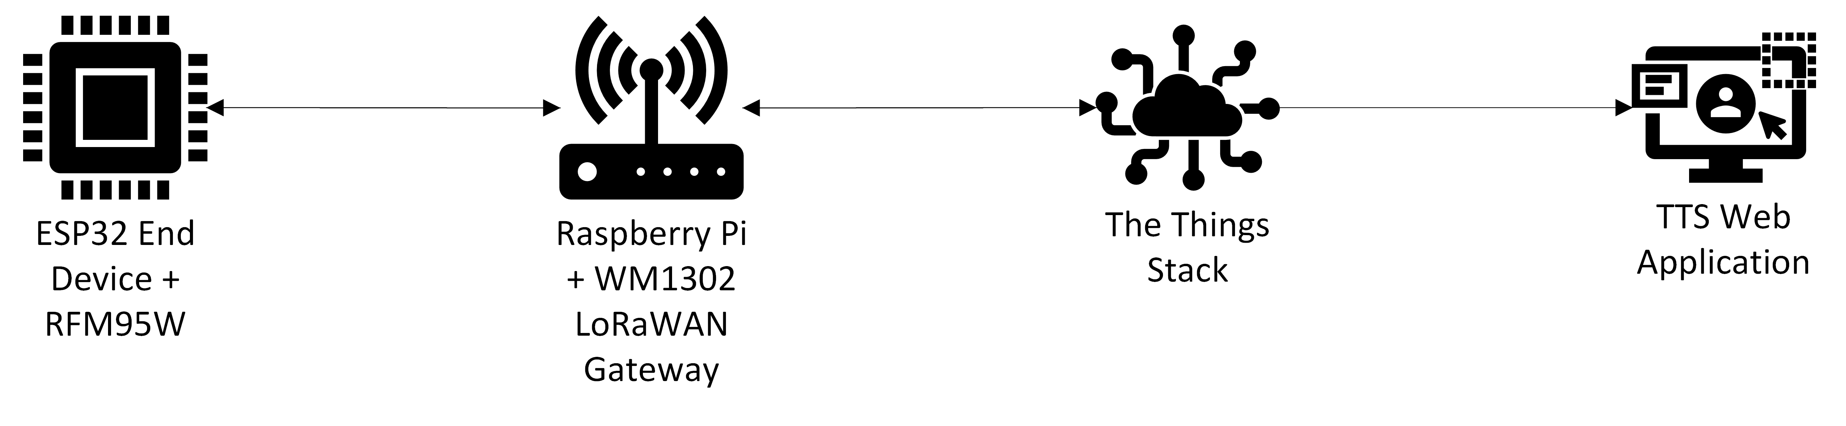
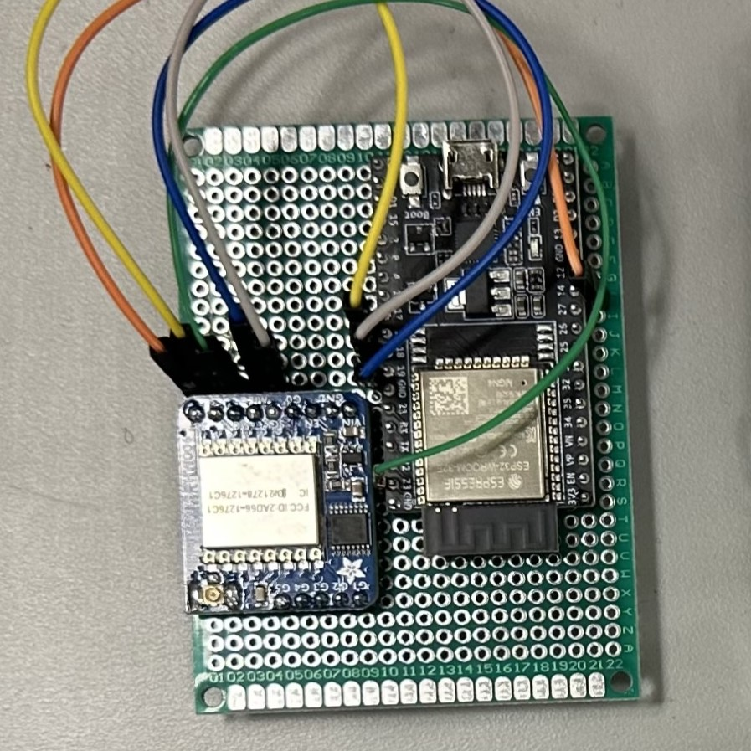
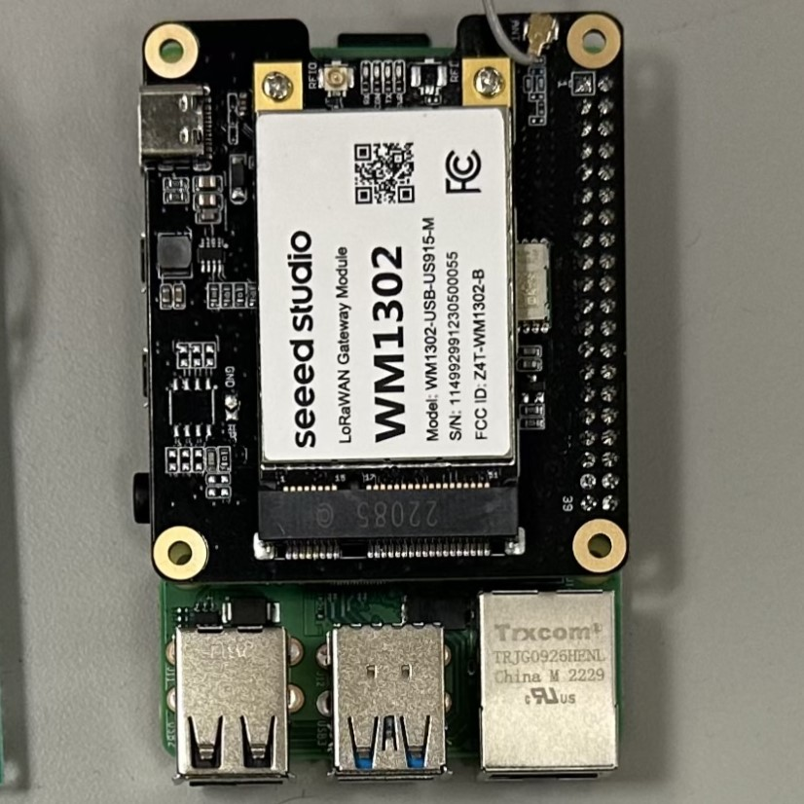
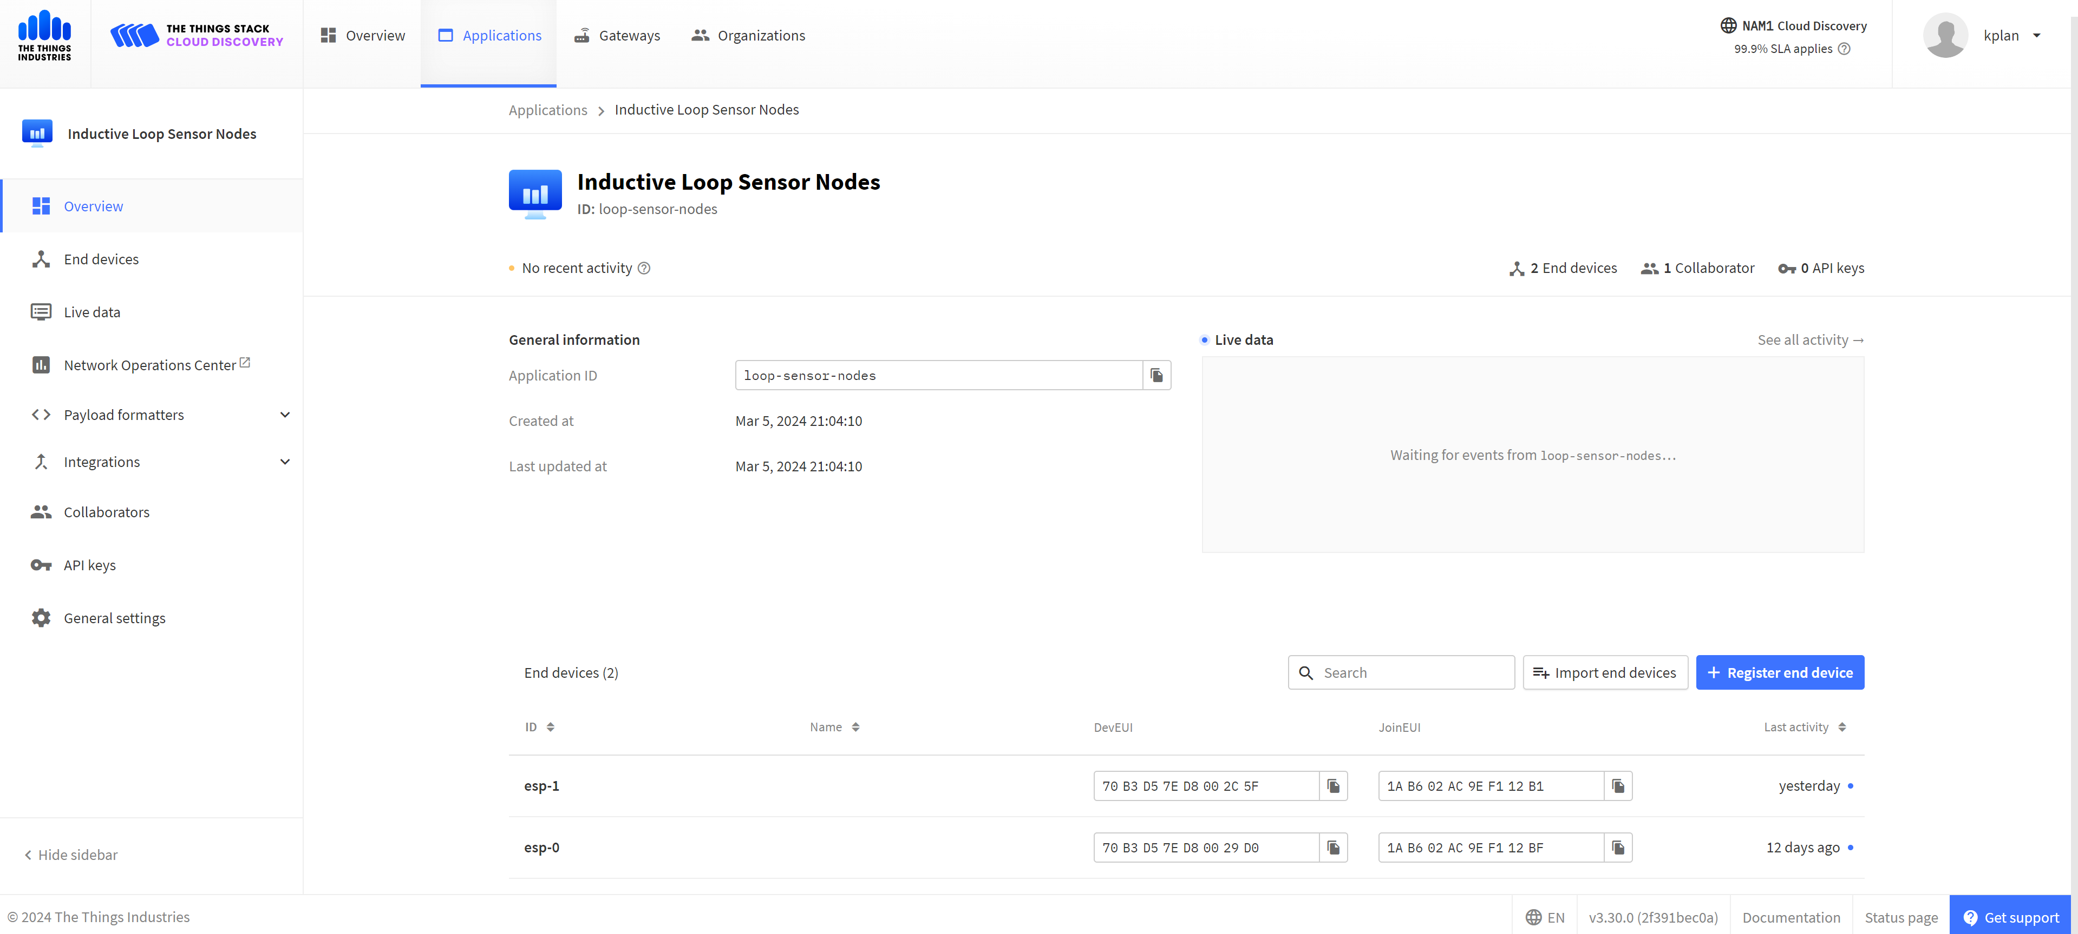
Data Processing – LoRaWAN Communication
Notes:
Our LoRaWAN network looks like this.
We have the ESP32 end devices which use RFM95W LoRa Radios to transmit data over LoRaWAN.
They send their data to the Raspberry pi based gateway which uses the WM1302 concentrator to demodulate LoRaWAN packets.
That gateway forwards the packets to our things stack network server.
And then the data appears in the user facing web application on the things stack.

Slide 15
LoRaWAN Scalability
Notes:
The web application looks like this.
It’s hosted by the things stack which provides LoRaWAN infrastructure such as Network servers, authentication servers and application servers.
I have created this Application called inductive loop sensor nodes.
You can easily add more gateways to the application and register more ESP end devices.
This means scaling the system across all of campus would be as simple as strategically placing gateways, registering them with the application, and also registering the additional ESP32 end devices.
The things stack can also be integrated with many other services. For example, we can use a webhook to send our data to the firebase mobile app developed by the last team who worked on this project.

Slide 16
Evolution of Measures of Success
Local Space Availability Retention is unnecessary.
Devices only keep track of their delta value.
Measure of Success | Details
Full Time Operation | All parts of the system shall be constantly functioning. This includes having a backup power supply.
Wireless Communication | The sensor shall communicate with the server wirelessly.
Space Availability Retention | The system shall keep a count of vehicles that enter or exit a parking lot.
Local Space Availability Retention | The sensor shall keep track of the number of vehicles in a parking lot locally.
Notes:
During the design process, we realized some of our measures of success have changed.
The Local Space Availability measure of success was deemed unnecessary.
Throughout the design of the project, we realized keeping a synchronized count of available spaces locally on every ESP32 would be infeasible and unnecessary.
Instead, only the change in vehicles, the delta, should be stored locally, the number of vehicles in a parking lot or the number of available spaces can be calculated and stored server side.
This way the ESP32s do not need to communicate among themselves to keep a value up to date.

Slide 17
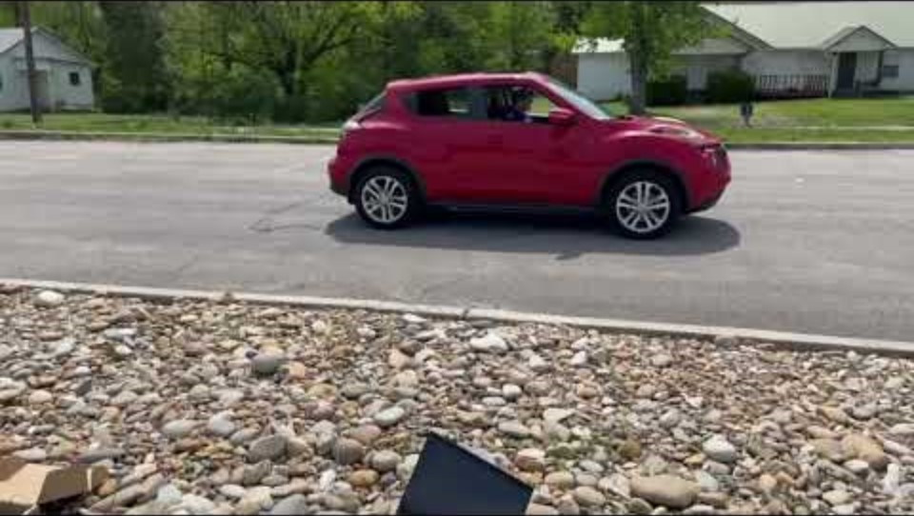
Video Demonstration
Notes:
YouTube Link: https://youtu.be/kGD3eaTffT4
We have recorded a video demonstration of a car driving over the loops at 5 mph to demonstrate how the delta changes and shows up in the things stack application.

Slide 18
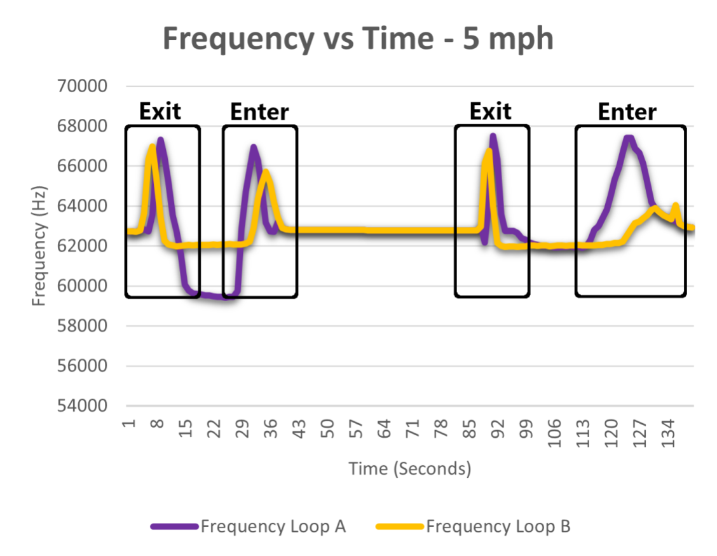
Notes:
Experimentation Results: ESP32 Frequency Measurement
1. Note the distance between the spikes for time between different events

Slide 19
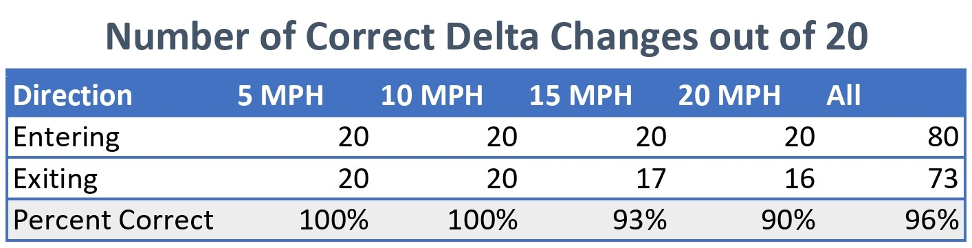
Ground Sensor Reliability
Notes:
We tested the reliability of the vehicle detector by running 20 tests at speeds of 5, 10, 15, 20 mph in the entering direction and 20 more for each of those speeds in the exiting direction.
Entering remained 100% accurate, as did 5 mph and 10 mph.
We only got a few wrong changes at 15 mph exiting and 20 mph exiting.
However, that may have something to do with those runs being at the end of testing.
The loops became worn and mishappen by then, and we could see the frequency of the loops had drifted a lot since the start of testing.
We still ended up with an overall accuracy of about 96%.

Slide 20
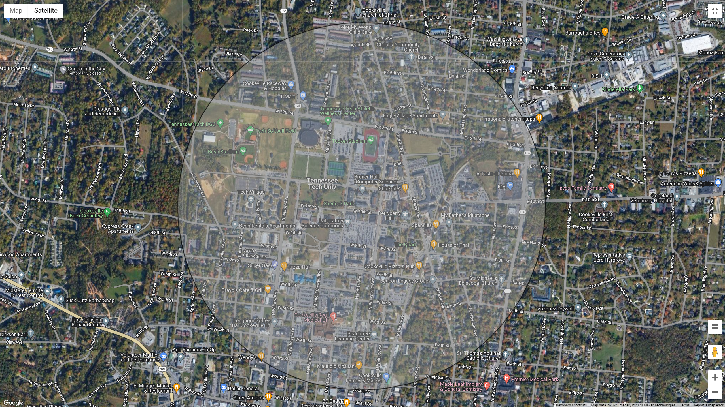
LoRaWAN Range
Notes:
After testing the range of the LoRaWAN network, I found that I could reliably get about 1 km of range.
This is a circle with a radius of 1 km centered at Brown Hall.
Clearly, the LoRaWAN network can cover all of campus.
However, valleys are challenging because when you get enough of the Earth between the gateway and end device you lose connection.
This makes certain parts of campus hard to reach unless multiple gateways were to be used.

Slide 21
Final Results
Measure of Success | Details | Achieved?
Full Time Operation | All parts of the system shall be constantly functioning. This includes having a backup power supply. | Yes
Wireless Communication | The sensor shall communicate with the server wirelessly. | Yes
Space Availability Retention | The system shall keep a count of vehicles that enter or exit a parking lot. | Yes
Local Delta Retention* | The sensor shall keep track of the number of vehicles in a parking lot locally. | Yes
Notes:
How the measures of the success have evolved over the project
FTO -> No change
WC -> No Change
LSAR -> Keep track of the change of vehicles instead of the amount of available spots
SAR -> No Change

Slide 22
Surpassed Expectations
Original Expectations | Results Achieved
Brown Lot to Capstone Lab (~150m) | Over 1km range
Detect something as vehicles drive over the loops | 96% reliability
No focus on scalability | Easy scalable across campus

Slide 23
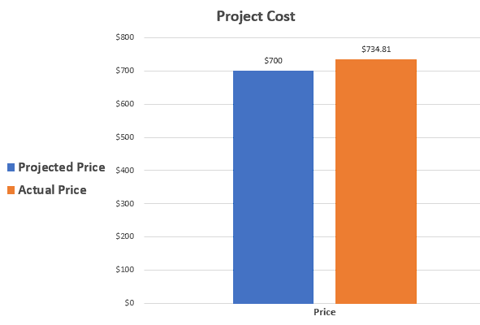
Budget

Slide 24
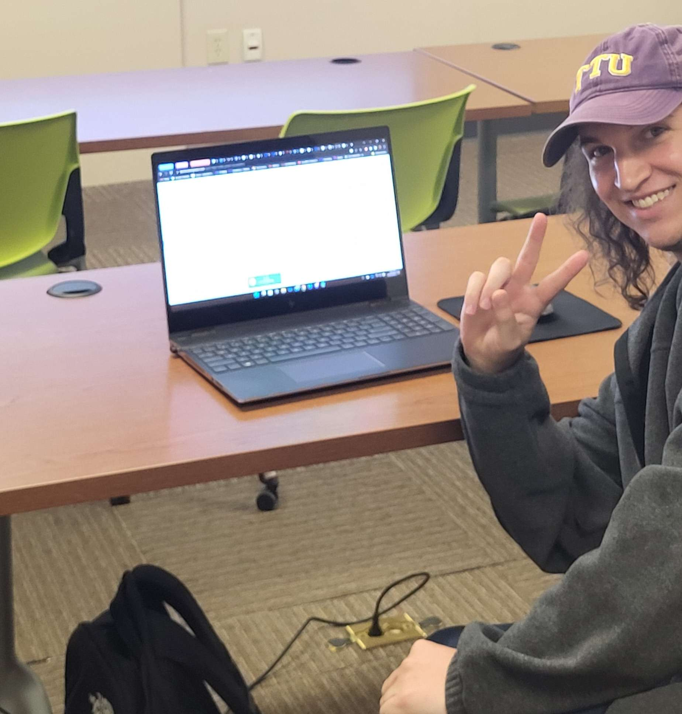
Questions?

